Slide 1
SELENIUM WEBDRIVER
Selenium Webdriver is an API that we gonna use to programmatically control web browser through a test script
Support multiple browsers: - Chrome, Firefox, IE, Safari
Support multiple languages: - Java, Javascript, PHP, C#...

Slide 2
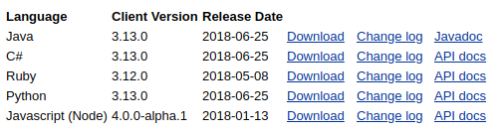
Setup WebDriver with Eclipse
Go to the page: https://www.seleniumhq.org/download/
Go to Documents folder on your computer and make new folder ‘Selenium’. Extract downloaded file in Selenium folder.
Run Eclipse and create new Java project
Create new java package: Right click on java Project, NEW >> PACKAGE
Create new Class: Right click on Package, NEW >> CLASS (check ‘public static void main(string[]args)’

Slide 3
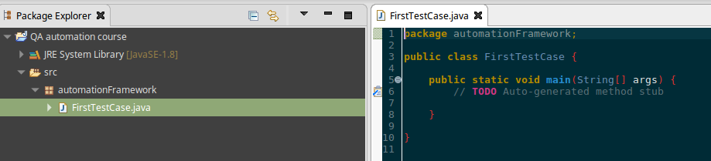
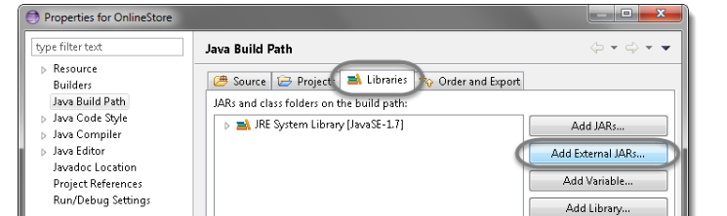
You should get window look like this:
Now add WebDriver jar files to Java build path:
Right click on project >> Properties >> Java build path
Navigate to Libraries and click Add External JARs

Slide 4
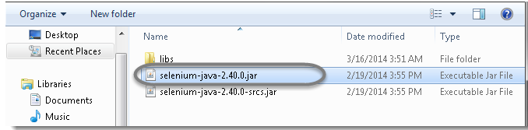
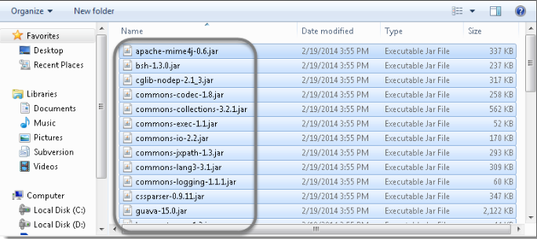
Add selenium-java.jar from extracted folder, you may add source file too.
Add all the jars from ‘libs’ folder.
Click OK

Slide 5
Add browser drivers to Environment Variables
Now you must teach your WebDriver how to work with different browsers. We are doing that by downloading drivers for particular browser:
Geckodriver (driver for Firefox)
Chrome driver
Safari driver
IE driver
Note: You will download drivers from different sites. Easiest way is to google it.
Example: search ‘geckodriver download’.

Slide 6

Let’s say we want to download chrome driver:
Go to the page: http://chromedriver.chromium.org/downloads
Download last version of chrome driver
Extract downloaded file to the folder where you will download drivers for all browsers.
Now we will set the property in environment variables:
Right click on My Computer >> Properties >> Advanced System Settings >> Environment variables

Slide 7
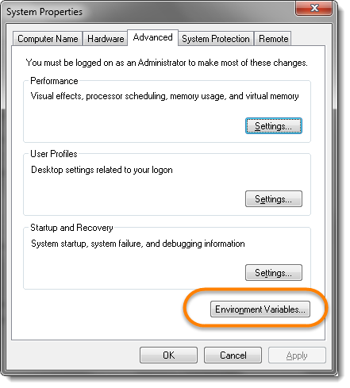
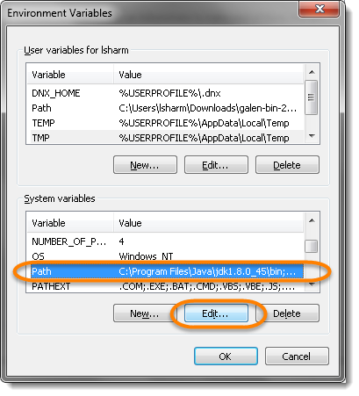
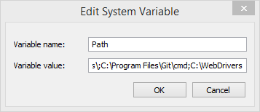
In the System Variables window scroll until you find ‘Path’ variable, select it and click Edit button
To the end of path first add semicolon ‘;’ (if there is one do not add it), then add path of folder in which you have extracted chrome driver, click ok.
Example: C:\WebDrivers

